Slide 1

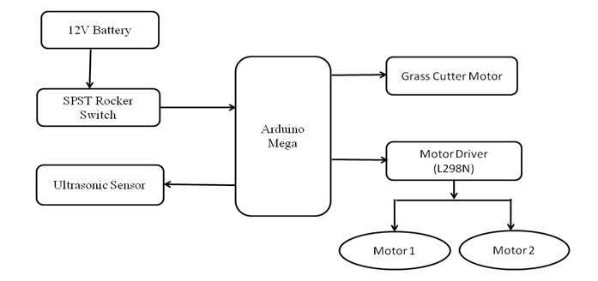
XAVIER INSTITUTE OF ENGINEERING DEPARTMENT OF INFORMATION TECHNOLOGY Internet of things AY-2019-20
SMART GRASS CUTTER
Group No 17: 05 – Shubham Chavan, 20 – Achal Kalwar, 31 – Rohan Mathur
Aim: Design a Smart Grass Cutter prototype using sensor and motor driver.
Features:
Avoids obstacle and moves in another direction.
Easy to move from one place to another place.
Operating principle is simple.
Circuit Diagram/Block Diagram:
Hardware & Software Requirements:
Arduino Mega 2560
Ultrasonic Sensor (HC-9R04)
Motor Driver (L289N)
DC Motors (12V)
SPST Rocker Switch
Wheels
Breadboard
Connecting Wires(M2M,M2F)
Arduino IDE
Windows OS

